Slide 1

CMPE 485 TERM PROJECT
2024
Ahmet Bera Pay
Mehmet Süzer

Slide 2

ACTION ADVENTURE
In the game industry, action-adventure is one of the most popular genres.

Slide 3
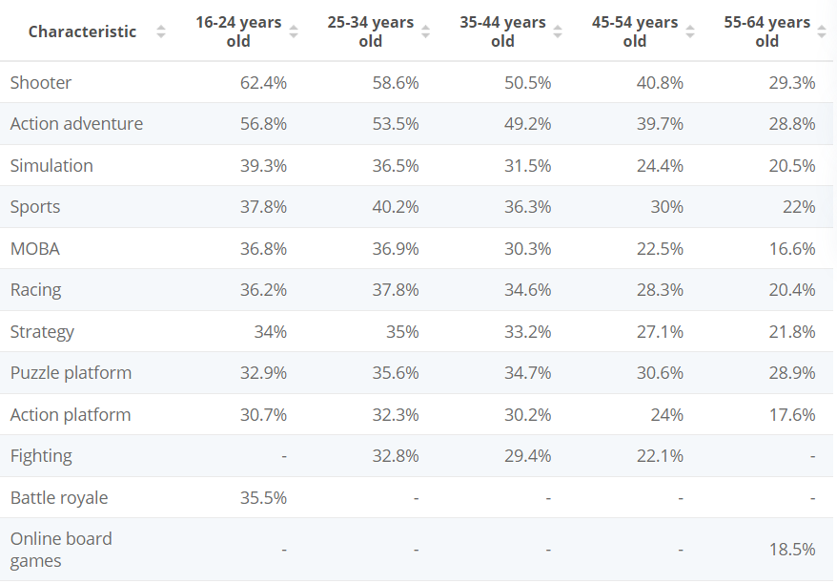
MOST POPULAR VIDEO GAME GENRES
3rd quarter of 2023
https://www.statista.com/statistics/1263585/top-video-game-genres-worldwide-by-age/

Slide 4
BATTLEFIELD SIMULATION
Action-Adventure games often require a large number of objects and effects to be rendered in a single scene. In addition, most of the objects are subject to be destroyed when a projectile hits. Therefore, we decided to focus on handling a high number of objects and effects in a single scene.

Slide 5

REALISM VS PERFORMANCE
It is difficult to achieve a balance between visual fidelity and performance when there are many objects and effects to handle.
Mount and Blade 2: Bannerlord

Slide 6
TECHNICAL CHALLENGES
Rendering lots game objects in the same scene
Handling many rigid bodies and collisions
Instantiating and rendering many particle effects such as blood and explosion

Slide 7
EXPERIMENT DESIGN
A destructible castle built out of individual bricks
Cannons firing cannonballs periodically
Particle effects (smoke, explosion, fire) for cannons
A high number of soldiers
Particle effects (blood, magic) for weapons

Slide 8
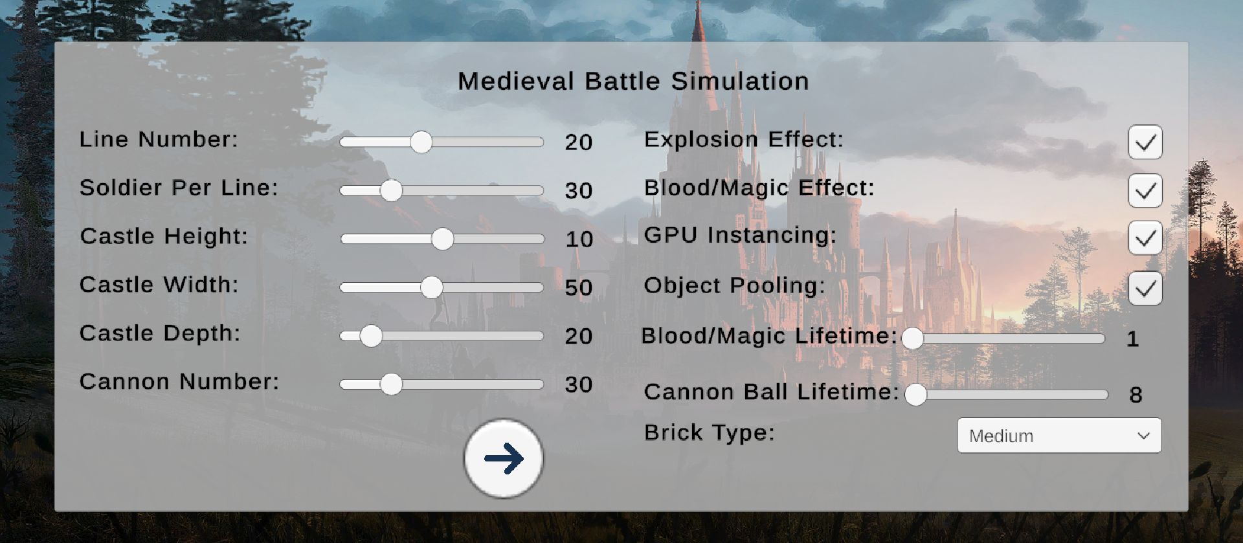
OUR CONTROL PANEL

Slide 9
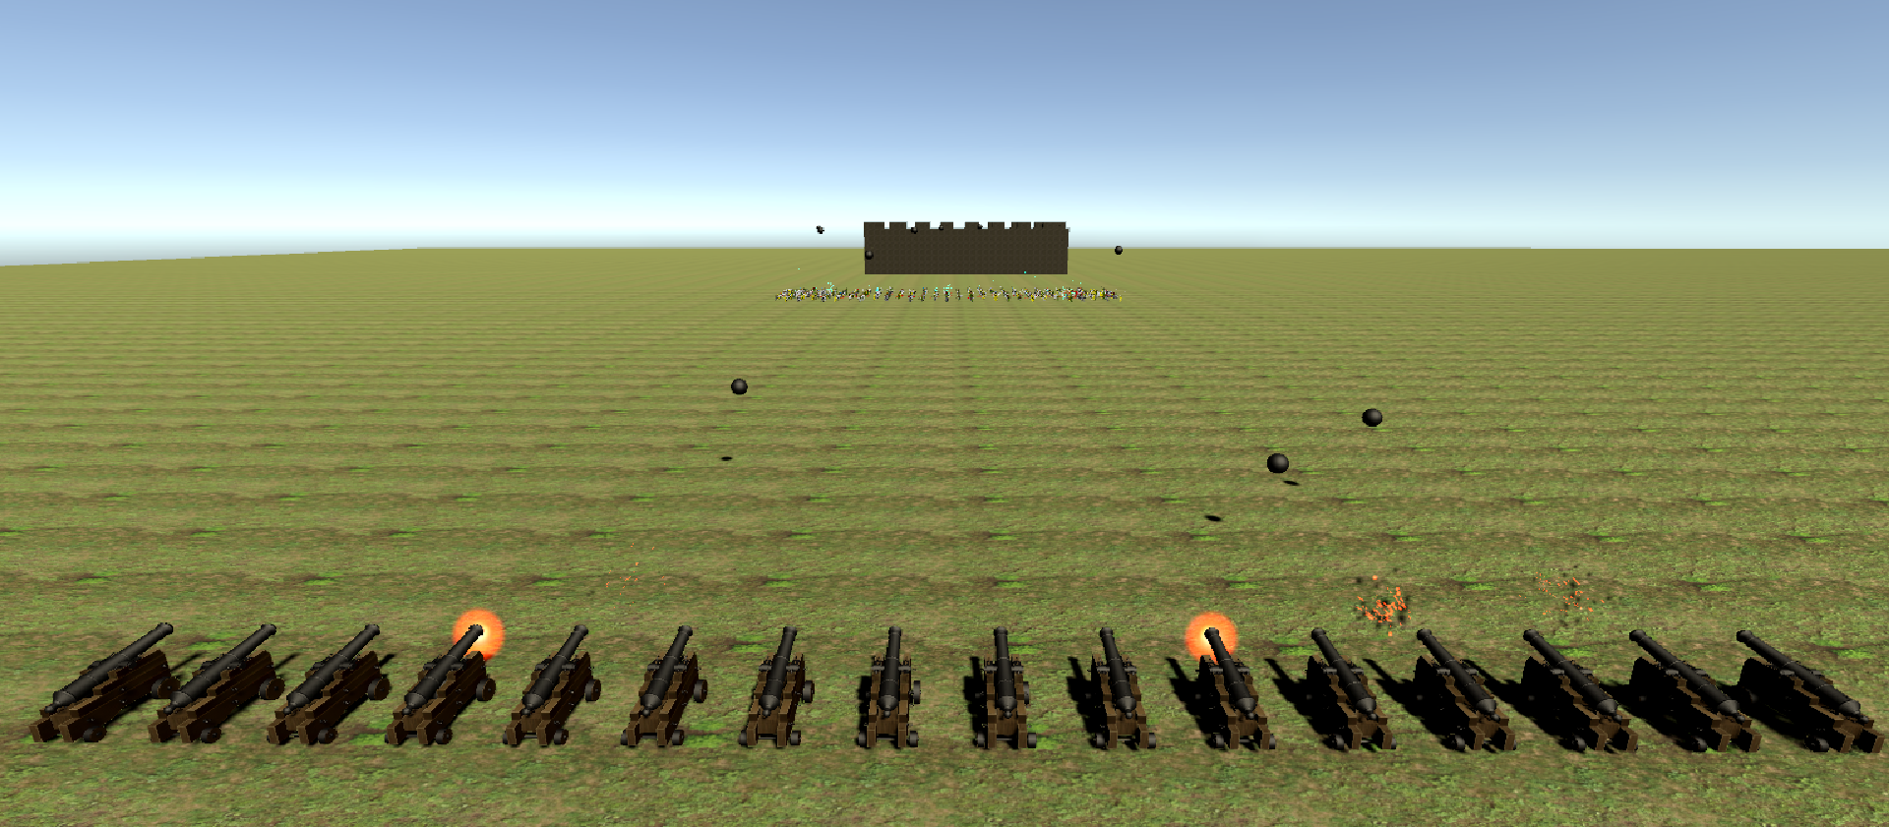
BATTLEFIELD

Slide 10
HOW TO IMPROVE?
Object pooling
Occlusion culling
GPU instancing
Level of Detail (LOD)

Slide 11
OBJECT POOLING
INTENT: Improve performance and memory use by reusing objects from a fixed pool instead of allocating and freeing them individually
Reduces memory allocation and deallocation overheads
Reduces memory fragmentation
Raises data locality

Slide 12
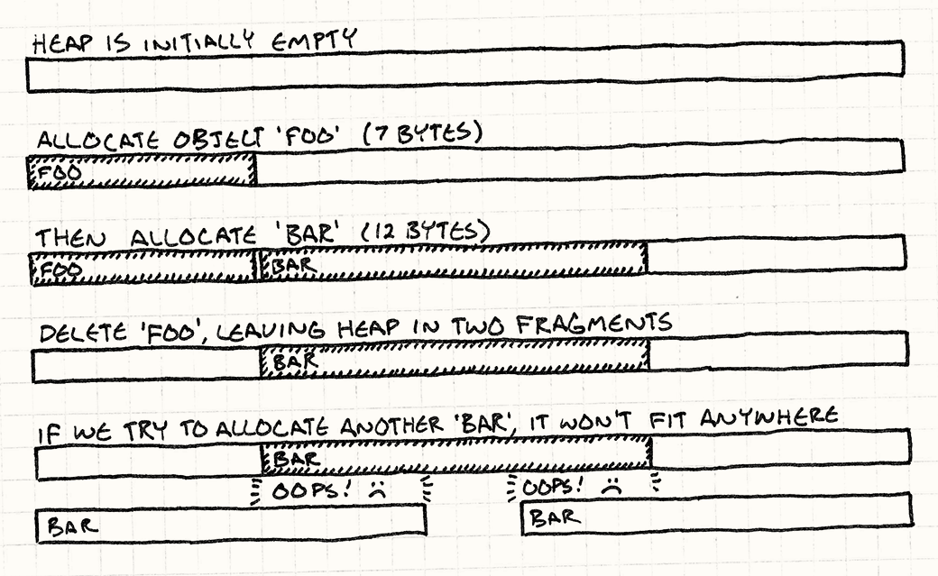
THE CURSE OF FRAGMENTATION
https://gameprogrammingpatterns.com/object-pool.html

Slide 13
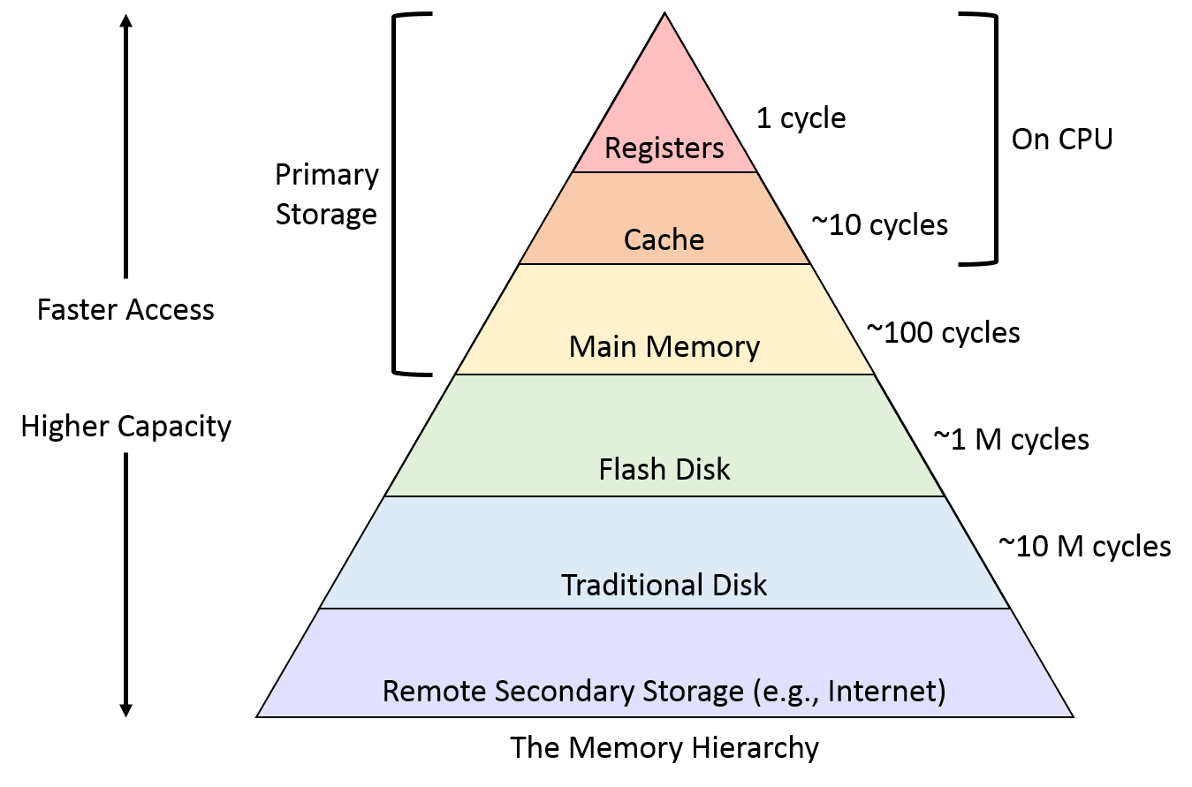
DATA LOCALITY

Slide 14
OCCLUSION CULLING
INTENT: Prevent GPUs from performing rendering calculations for game objects that are completely hidden from view (occluded) by other game objects
Reduces GPU overhead

Slide 15
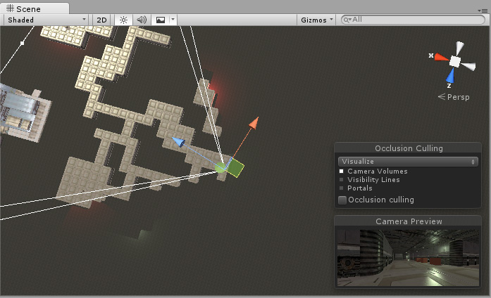
OCCLUSION CULLING
https://docs.unity3d.com/Manual/OcclusionCulling.html

Slide 16
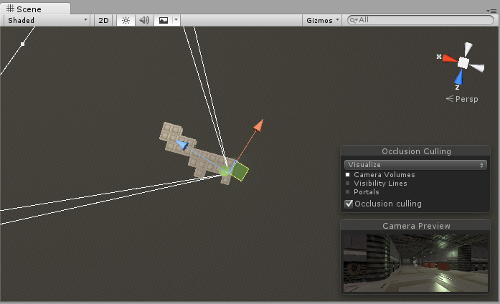
OCCLUSION CULLING
https://docs.unity3d.com/Manual/OcclusionCulling.html

Slide 17
GPU INSTANCING
INTENT: Render multiple copies of a mesh with the same material in a single draw call
To add variations and reduce the appearance of repetition, each instance can have different properties such as color or scale.

Slide 18

GPU INSTANCING
Shadow of the Tomb Raider

Slide 19
LEVEL OF DETAIL (LOD)
INTENT: Reduce the number of GPU operations to render distant meshes
When a game object in the scene is far away from the camera, you see less detail compared to when it is close to the camera. However, GPU still uses the same number of triangles to render the game object.

Slide 20
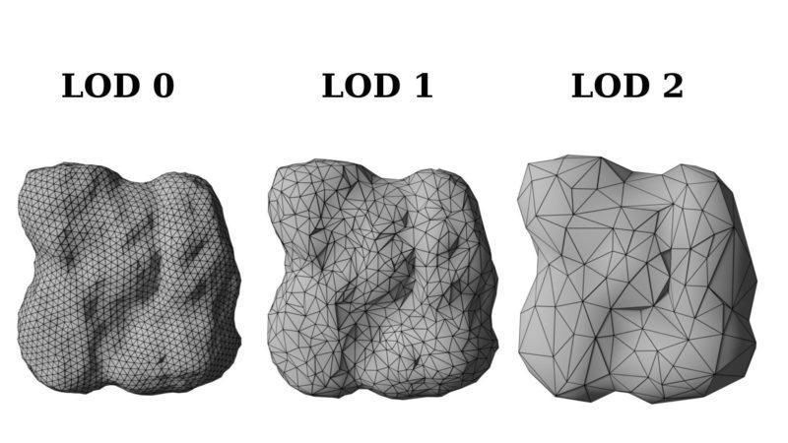
LEVEL OF DETAIL (LOD)

Slide 21
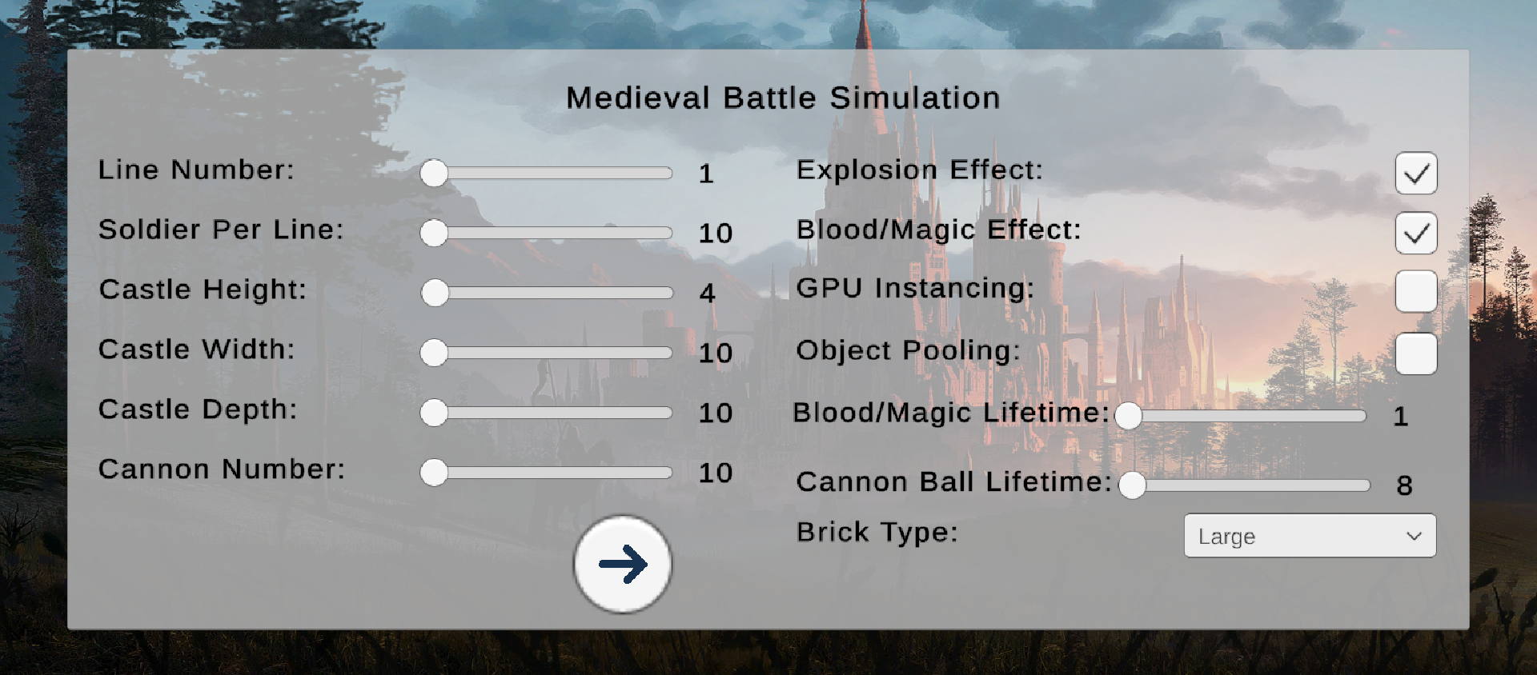
EXPERIMENT 1
Setup:
Few objects
Enabled effects
No GPU instancing
No Object Pooling

Slide 22
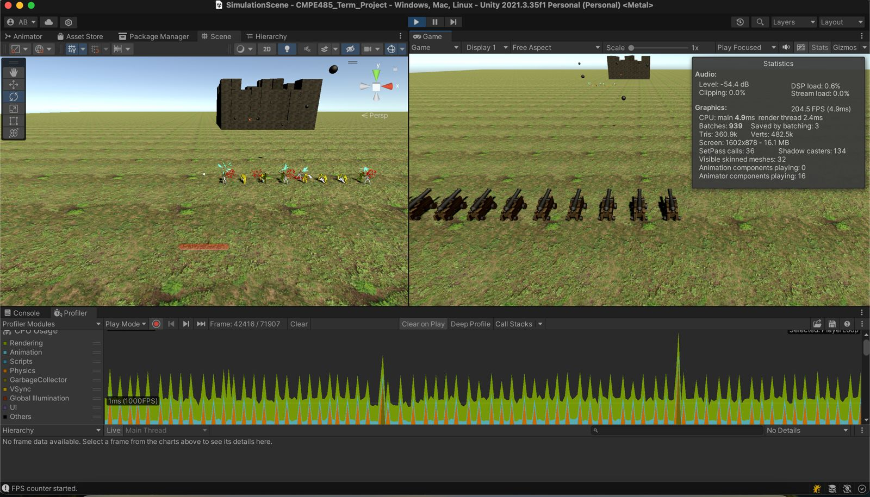
RESULTS 1

Slide 23
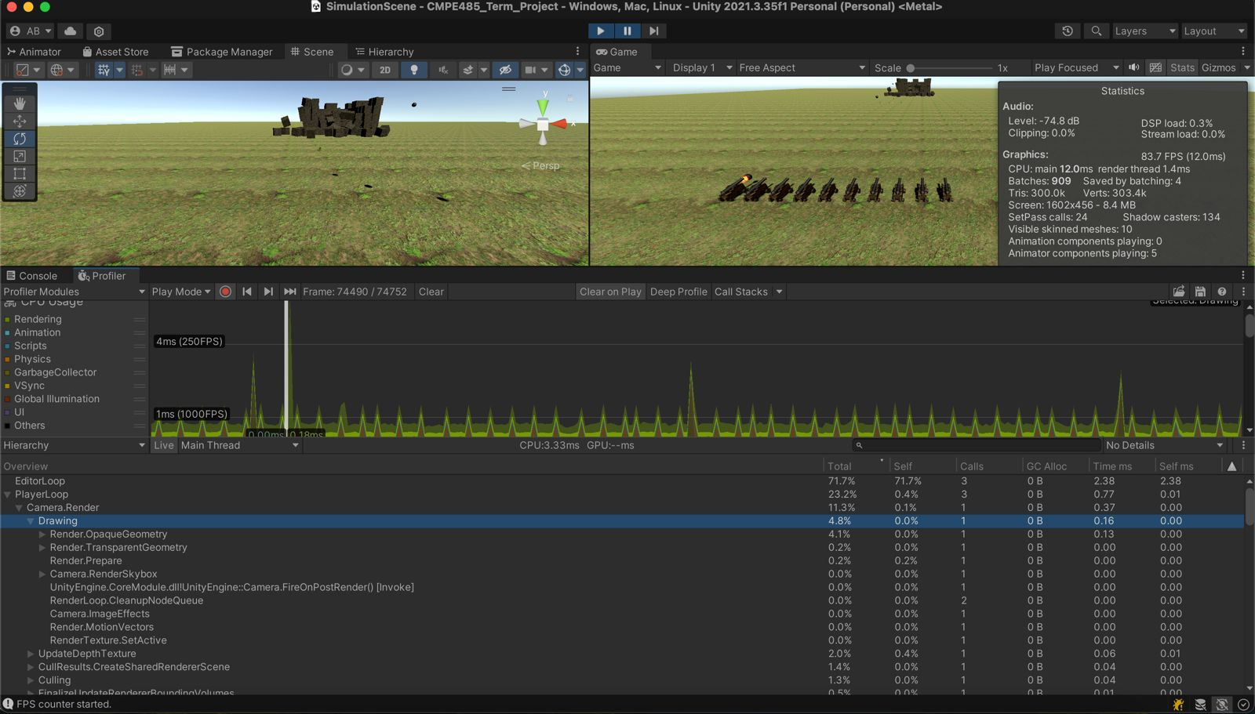
RESULTS 1

Slide 24
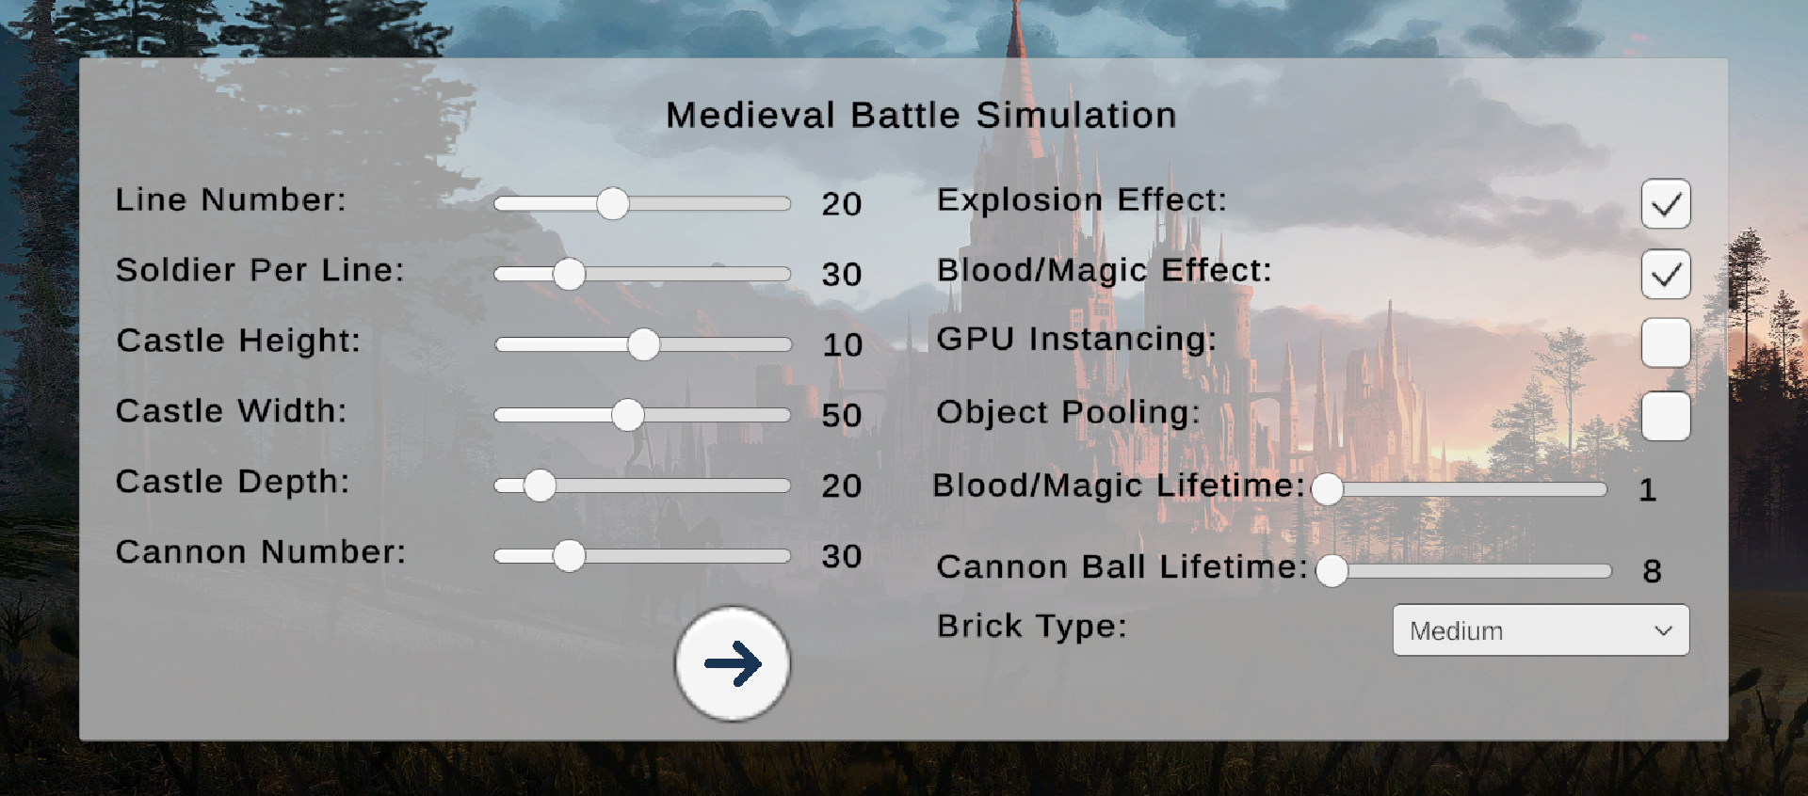
EXPERIMENT 2
Setup:
Many objects
Enabled effects
No GPU instancing
No Object Pooling

Slide 25
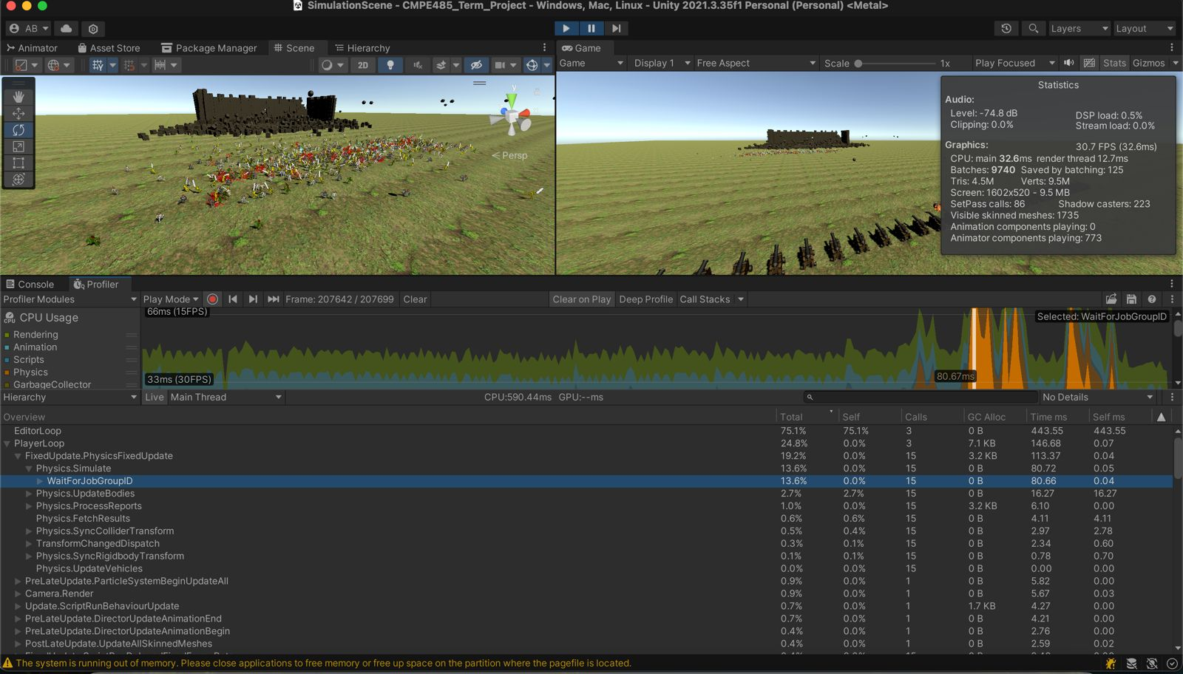
RESULTS 2

Slide 26
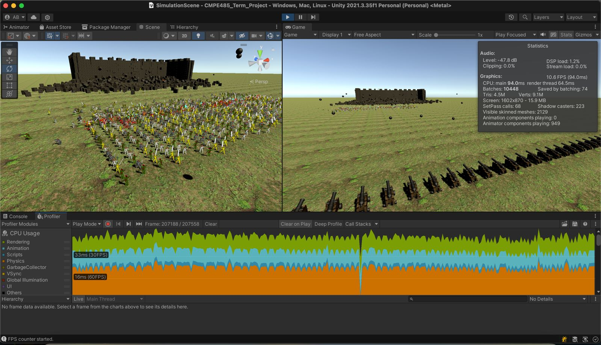
RESULTS 2

Slide 27
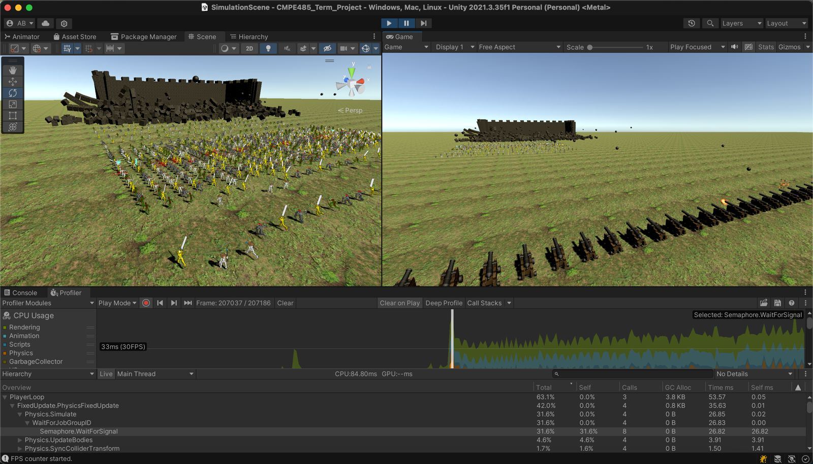
RESULTS 2

Slide 28
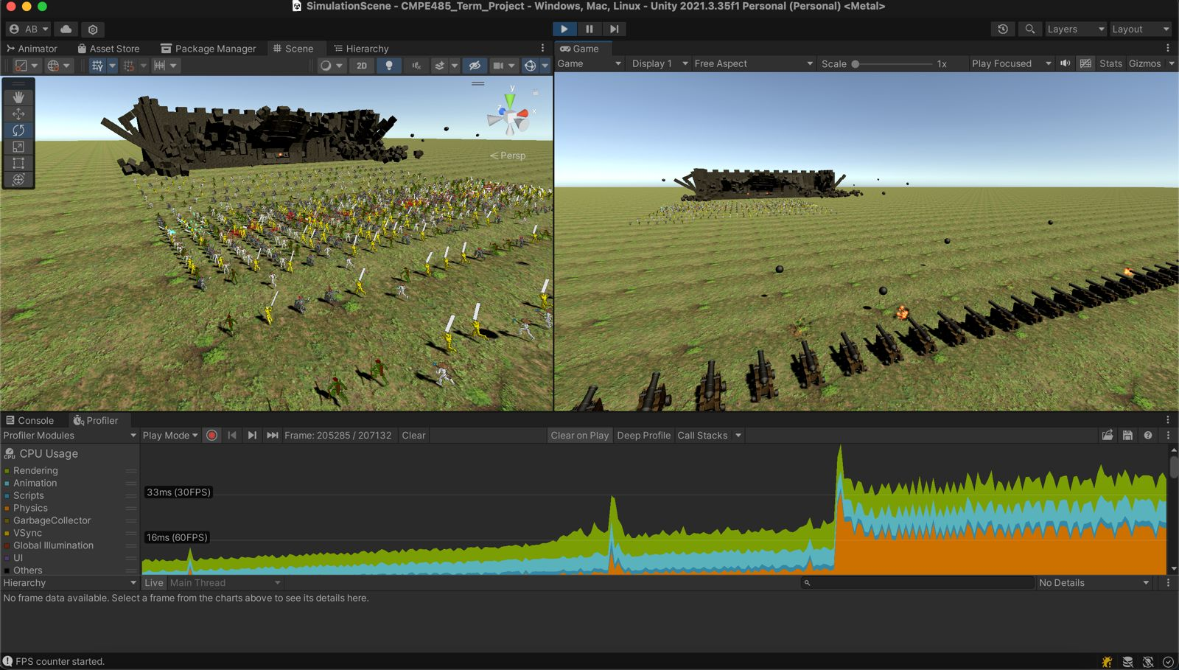
RESULTS 2

Slide 29
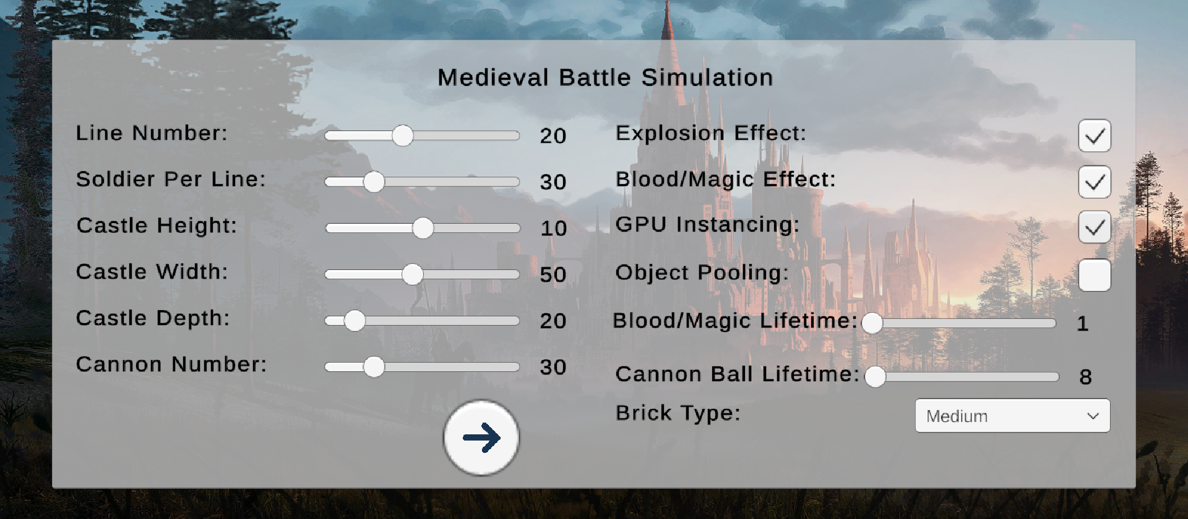
EXPERIMENT 3
Setup:
Many objects
Enabled effects
GPU instancing
No Object Pooling

Slide 30
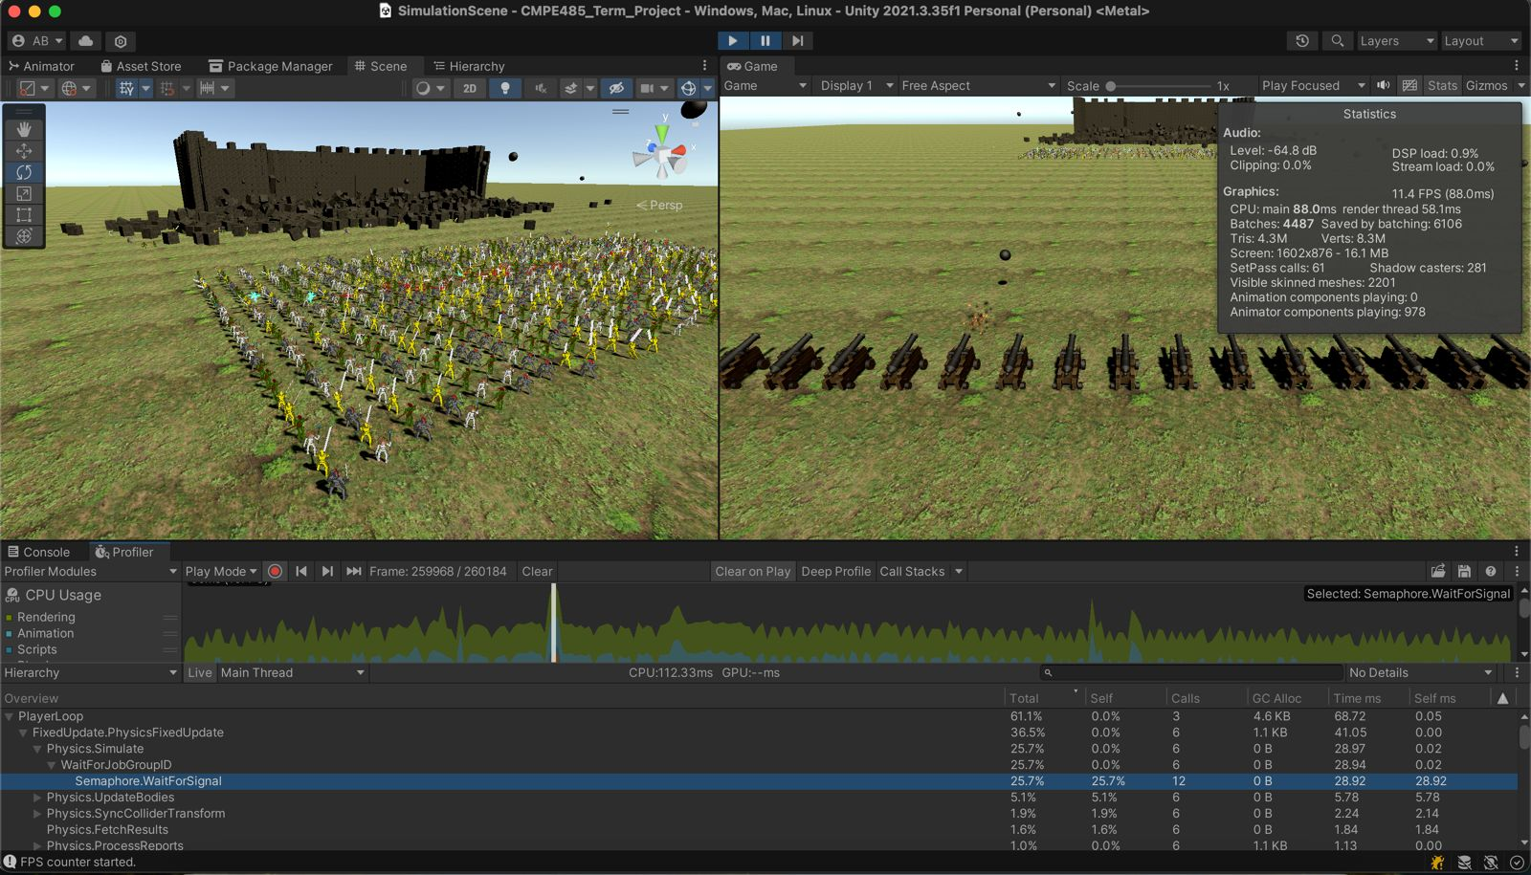
RESULTS 3

Slide 31
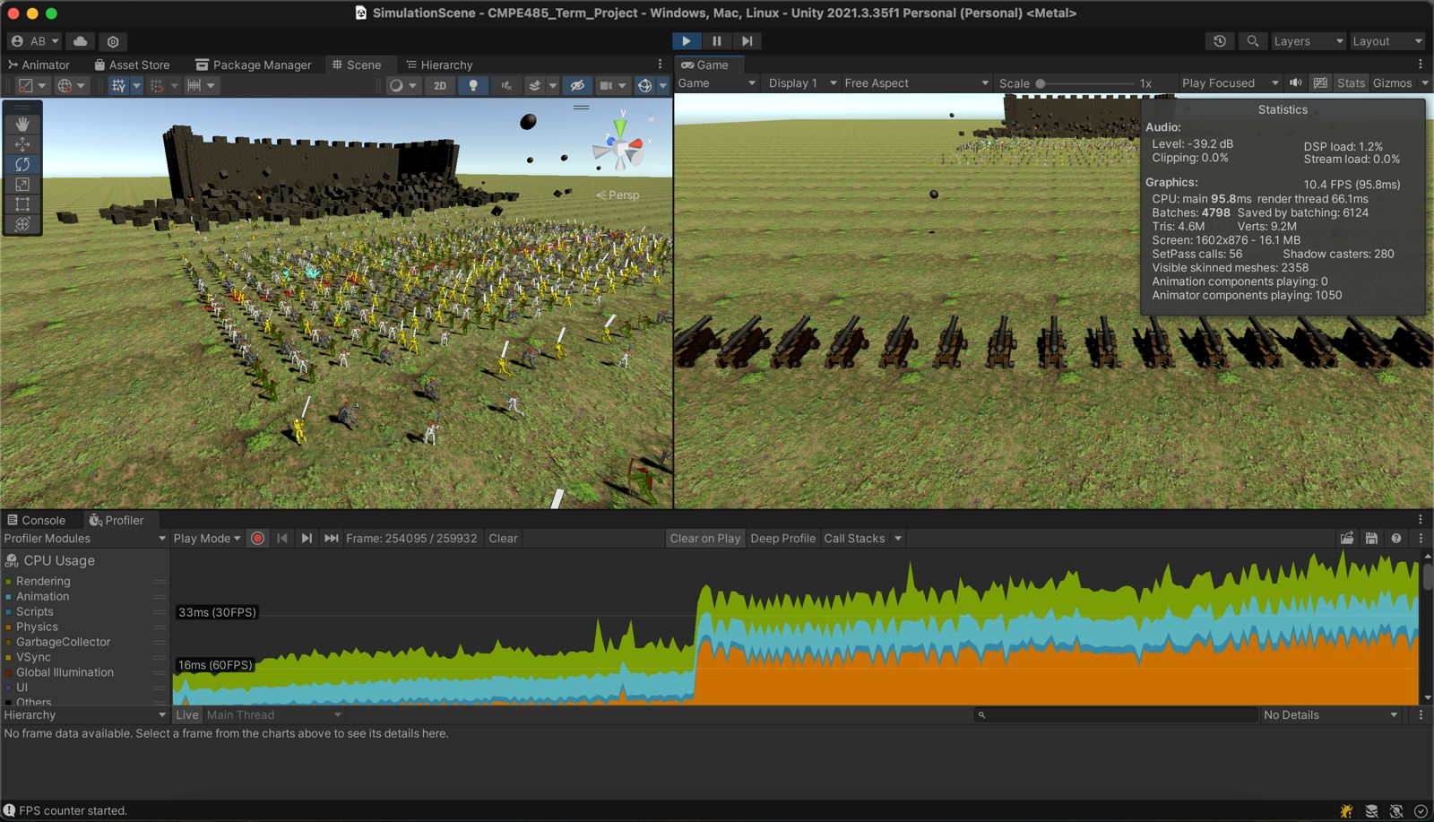
RESULTS 3

Slide 32
EXPERIMENT 4
Setup:
Many objects
Enabled effects
GPU instancing
Object Pooling

Slide 33
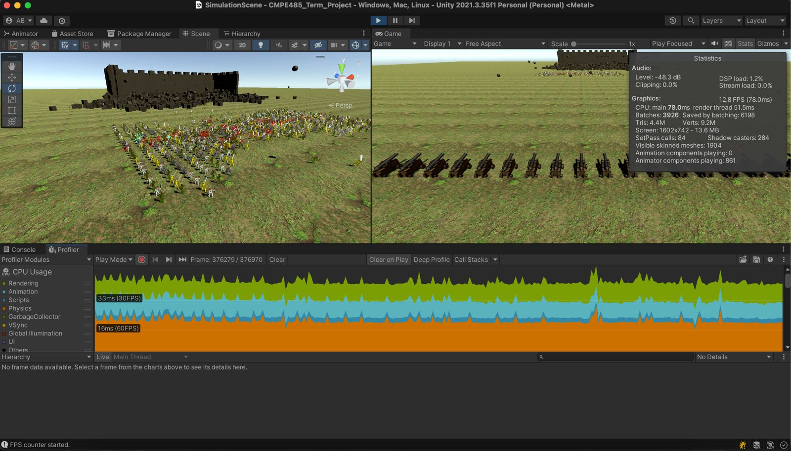
RESULTS 4

Slide 34
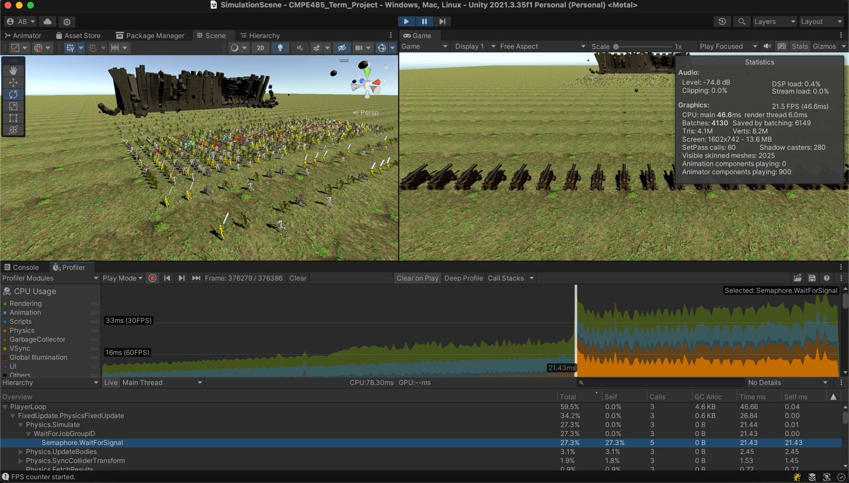
RESULTS 4

Slide 35
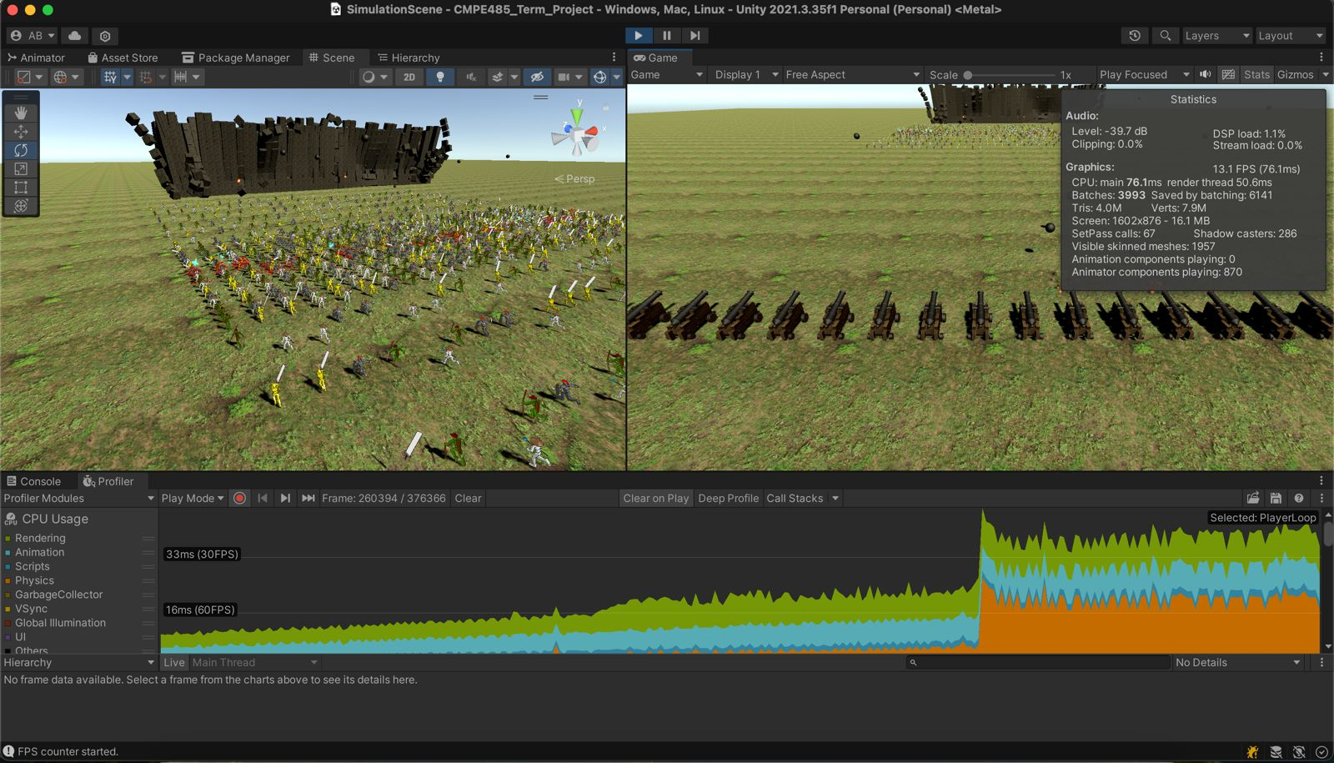
RESULTS 4

Slide 36

THANK YOU!

